Slide 1
Smartphone-Based Gait Recognition
Accenture Student Research Project
December 18, 2018
Students:
FÜLÖP Timea, MILLE János,
NÉMETH Krisztián-Miklós
Information Science III.
Supervisor:
dr. ANTAL Margit
Notes:
FT
Third year information science students from Sapientia.
The title of our project...

Slide 2
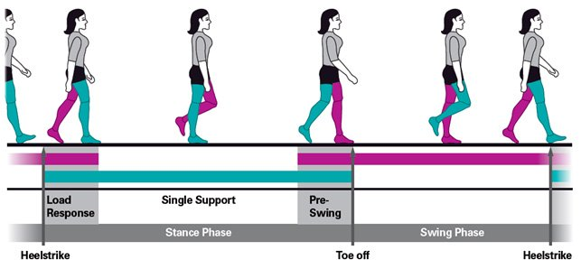
Outline
General Idea
Objectives
Related works
Application
Results
Notes:
FT

Slide 3
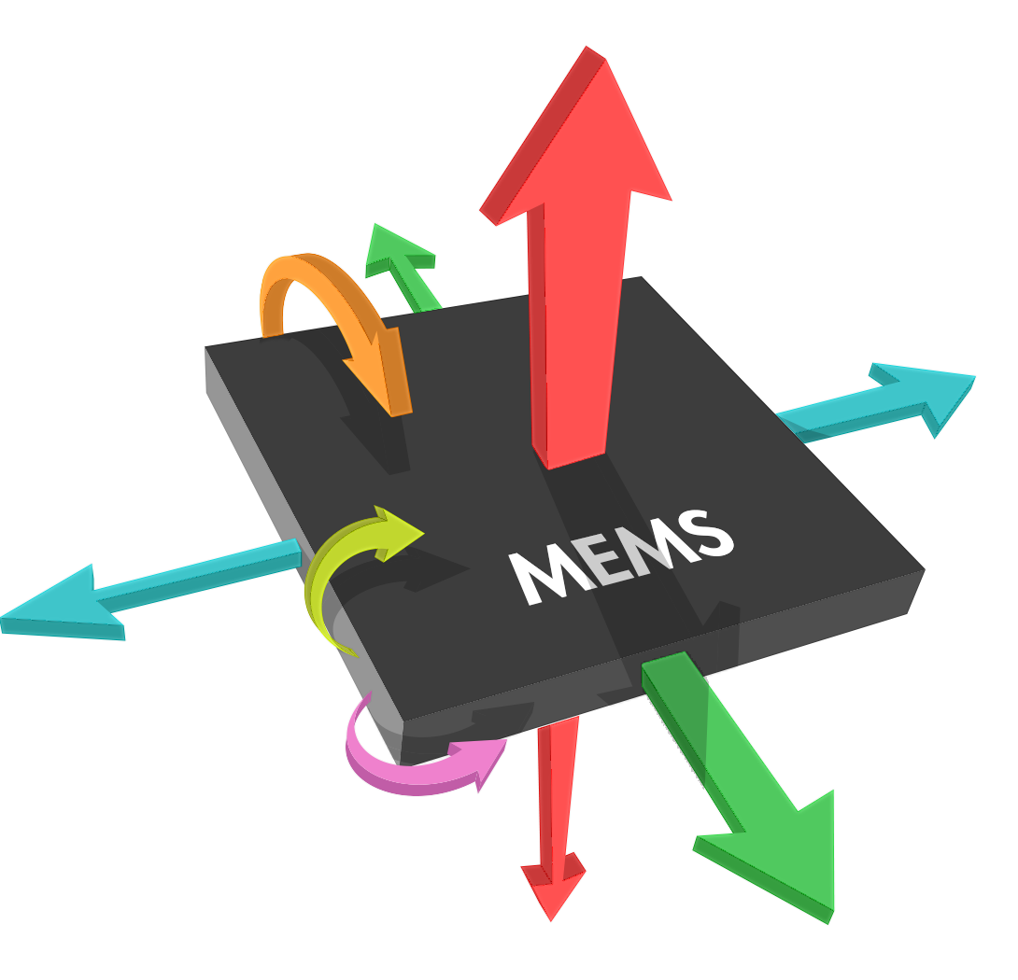

General Idea
Approaches
Camera/Video-based
Floor-sensor based
Inertial Sensors based
Notes:
FT
Who doesn’t want to know they and their and their valuables are safe? No one. We use locks on doors, phones, cars, everywhere. Some of these can be opened with a key, others use passwords or biometric samples like fingerprints.
This study deals with gait biometrics.
There are some technical approaches of gait biometric recognition like camera based, floor-sensor based and inertial sensor based ones. We decided to use the last one.
Gait biometrics can also be used in healthcare, for detecting diseases or in sports, for maintaining proper workout forms, for example.

Slide 4
General Idea
Approaches
Camera/Video-based
Floor-sensor based
Inertial Sensors based
Usage
Healthcare
Sports
Security - access control system
Notes:
FT
Who doesn’t want to know they and their valuables are safe? No one. We use locks on doors, phones, cars, everywhere. Some of these can be opened with a key, others use passwords or biometric samples like fingerprints.
This study deals with gait biometrics.
There are some technical approaches of gait biometric gesture recognition like camera based, floor-sensor based and inertial sensor based ones. We decided to use the last one.
Gait biometrics can also be used in healthcare, for detecting diseases or in sports, for maintaining proper workout forms, for example.

Slide 5
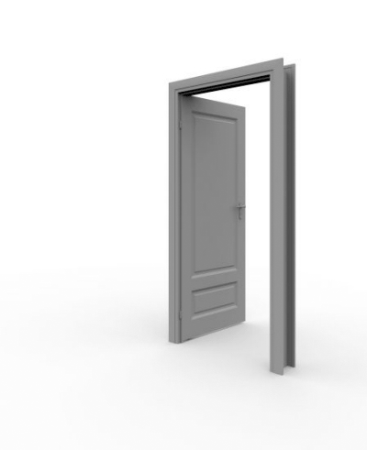


Objectives
Access Control System
Feature extraction library
Machine learning algorithm
Data collection - Android application
Notes:
FT
Our objective is to create an Access Control System. But before this we have to take some smaller steps. First, we need a Feature Extractor to obtain some features from raw data. For this we need to implement our own library. Second, we trained a classifier using machine learning. Third, we need an application to collect biometric data from users.

Slide 6
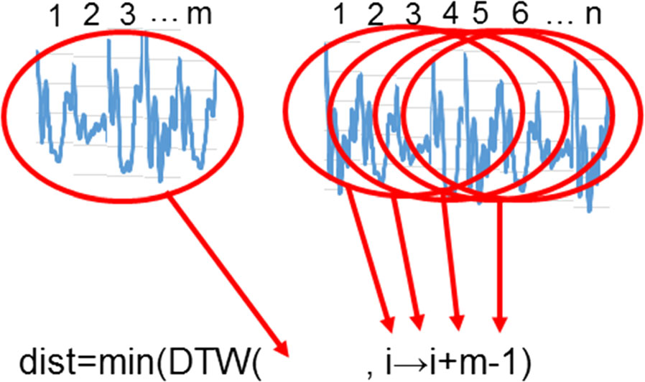
Related Works
MARSICO - 2017 (Univ. Sapienza, Rome)
Dynamic Time Warping
8,9% EER (ZJU-GaitAcc)
Notes:
NK
-there are several research projects with similar topics
-three of those are: …
1. they used DTW and reached an 8.9% equal error rate on their dataset
2. they work a lot by detecting the step period and during the tests they conducted they noticed that the accelerometer alone provides a better error rate than the combination of an accelerometer and a gyroscope (img middle)
3. they put great emphasis on feature extraction using the classical manual methods and using a CNN

Slide 7
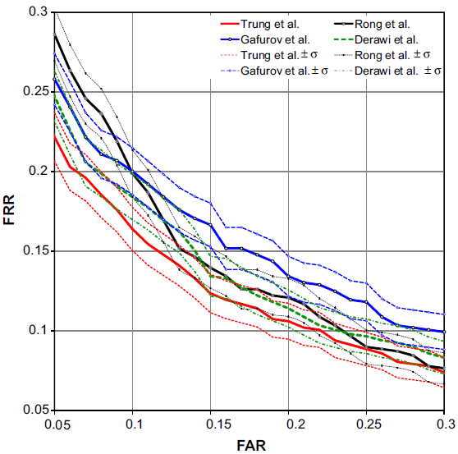
Related Works
MARSICO - 2017 (Univ. Sapienza, Rome)
Dynamic Time Warping
8,9% EER (ZJU-GaitAcc)
NGO - 2014 (Osaka Univ.)
period detection
accelerometer > gyroscope
Notes:
NK
-there are several research projects with similar topics
-three of those are: …
1. they used DTW and reached an 8.9% equal error rate on their dataset
2. they work a lot by detecting the step period and during the tests they conducted they noticed that the accelerometer alone provides a better error rate than the combination of an accelerometer and a gyroscope (img middle)
3. they put great emphasis on feature extraction using the classical manual methods and using a CNN

Slide 8
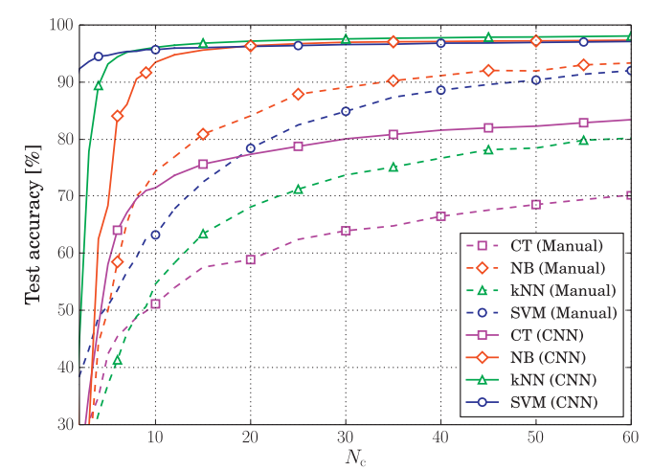
Related Works
MARSICO - 2017 (Univ. Sapienza, Rome)
Dynamic Time Warping
8,9% EER (ZJU-GaitAcc)
NGO - 2014 (Osaka Univ.)
period detection
accelerometer > gyroscope
GADALETA - 2018 (Univ. Padova)
feature extraction
IDNet dataset
Notes:
NK
-there are several research projects with similar topics
-three of those are: …
1. they used DTW and reached an 8.9% equal error rate on their dataset
2. they work a lot by detecting the step period and during the tests they conducted they noticed that the accelerometer alone provides a better error rate than the combination of an accelerometer and a gyroscope (img middle)
3. they put great emphasis on feature extraction using the classical manual methods and using a CNN

Slide 9
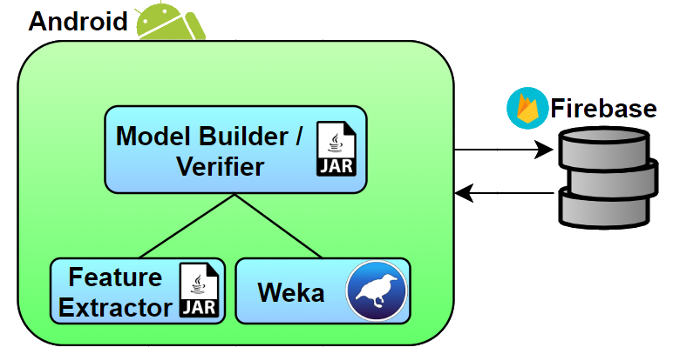
Application
Notes:
So, I will be talking about the application.
The diagram shows the android application and the modular architecture including the two main modules developed by us, the Feature Extractor and the Model Builder.
We are using Weka to classify the processed data, and Firebase to store data for our application.
Now I will let my teammates present these two modules.

Slide 10
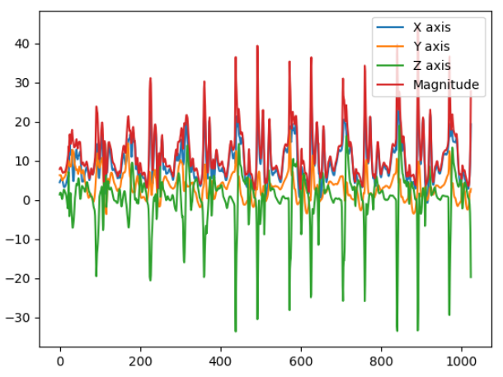
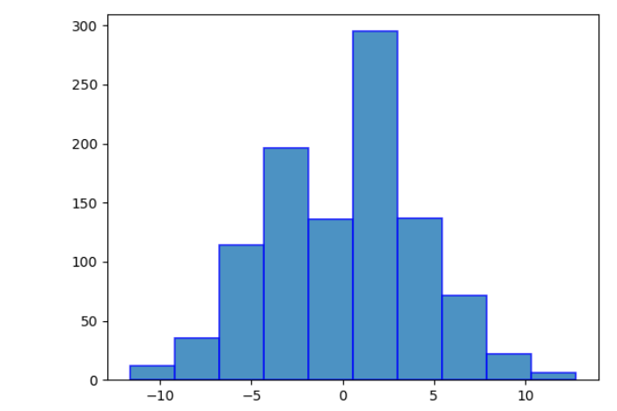
Feature Extraction
minimum points
mean values
standard deviations
mean absolute differences
zero crossing rates
histograms
Notes:
NK
We created a library that offers services for feature extraction based on different settings we want to use.
The enumerated features are extracted from each axis and the magnitude of the recorded signal (img 1) (=sqrt(ax^2+ay^2+az^2))
img 2 = histogram, distribution of the recorded values within a frame

Slide 11



II. Machine-Learning
Weka library
Binary classifier
Model creation
Validation
Notes:
FT
If we want to recognize people by their gait patterns, everyone needs to be modeled first. We’ll use this later to evaluate further data, and to determine whether those belong to the user which is genuine user or to an imposter.
We used the data provided by the user to make the model. We extracted the features using Feature Extractor. These features serve as positive data, and using the same amount of negative data, we made a classifier for the user. Negative data were collected from random individuals, and we extracted the features from those.
All that’s required for validation is to load the existing model into a binary classifier, and to extract the features from fresh raw data. By comparing these, we get a value, which tells us the likelihood of not dealing with an imposter.

Slide 12
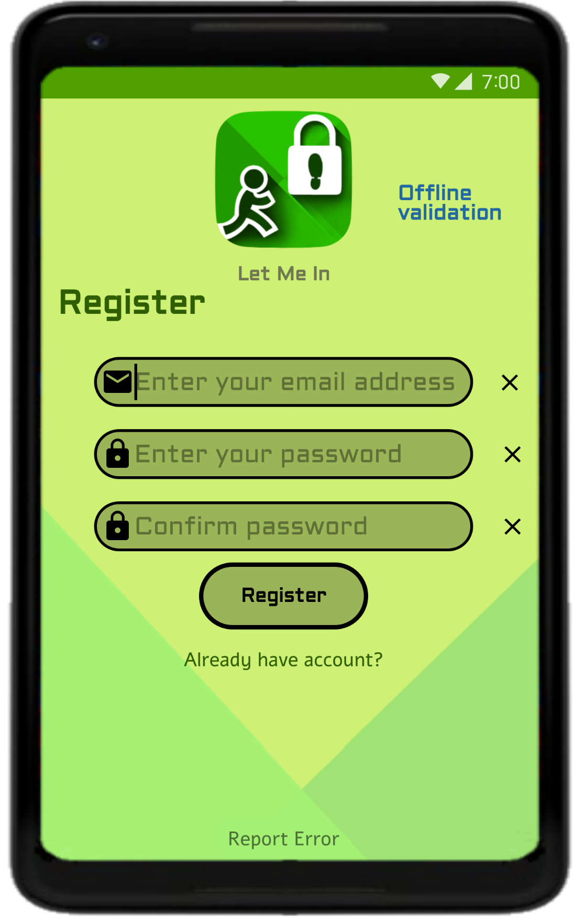
III. Android application
App with friendly UI
User registration and login
Raw data collecting
Model generation
User validation
Storing data in Firebase
Notes:
We wanted to develop an app with a user friendly Interface that had to include the following functionalities:
Users have to create an account and log-in in order to use:
raw data collector, model generator, gait validation
As I mentioned before, users raw datas and models are stored in Firebase Storage and Users are stored using Firebase Authentication service.
- (And) We are going to show the demo at the end of the the presentation.

Slide 13
RESULTS
GAIT CHANGES OVER TIME
ML Alg. | Training | Testing | Prec. | AUC | EER
KNN | S1 | S1 | 0,93 | 0,96 | 0,06
KNN | S1 | S2 | 0,80 | 0,86 | 0,16
RF | S1 | S1 | 0,94 | 0,98 | 0,04
RF | S1 | S2 | 0,71 | 0,87 | 0,15
Dataset:
ZJU-GaitAccel
153 users, 2 sessions
S1: session1
S2: session2
Fs = 100 Hz
Binary classifiers:
balanced training data
Validation:
one step cycle
Notes:
NK (AUC = Area Under the ROC Curve ~ false positive / distinguished classes)
The table shows the precision and EER of two classifiers on two different sessions of the GaitAccel dataset.
The cross-session result show a decrease in the AUCs value...
As you can see …(mi a lenyeg???/RF)

Slide 14
RESULTS
2. STEP CYCLES vs. FIXED-LENGTH FRAMES
Unit | Training | Testing | Prec. | AUC | EER
Cycle | S1 | S1 | 0.94 | 0.98 | 0.04
128 samples | S1 | S1 | 0.94 | 0.98 | 0.05
Cycle | S1 | S2 | 0.71 | 0.87 | 0.15
128 samples | S1 | S2 | 0.74 | 0.87 | 0.16
Random Forest classifier
balanced
Verification - 1 unit:
one step cycle
1 frame (128 samples)
Notes:
NK
The figure shows a comparison between the results of the Random Forest classifier on features extracted from one step cycle and features extracted from one frame of 128 samples (contains with a high probability a step cycle).
As you can see the differences are insignificant and based on this we decided to use fixed frames for feature extraction

Slide 15
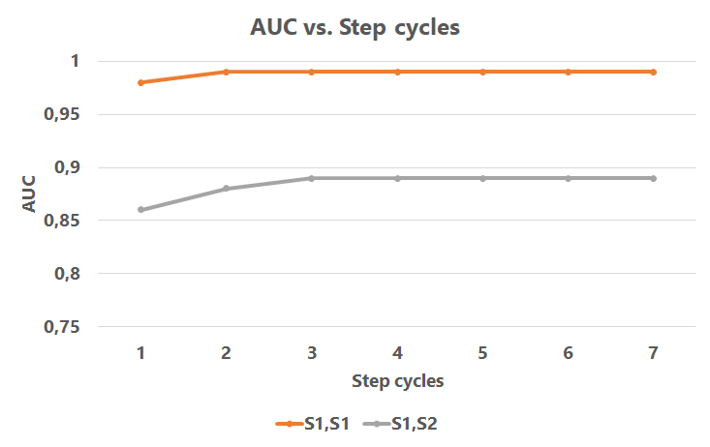
RESULTS
3. Required number of step cycleS for validation
Random Forest Classifier
balanced training data
validation: 1 - 7 step cycles
Notes:
NK
The diagram presents the evolution of the classifier’s AUC as we increase the number of step cycles
and it becomes reliable once 5 or more step cycles are recorded

Slide 16

Summary
Cross-session evaluation: precision decreases with 10 - 20%
Using frames ≈ Using step cycles
Minimum 5 step cycles for reliable result
Notes:
So let’s summarize:
First of all, we have reached the conclusions that gait is changing over time
and that using frames provides the same results as using step cycles
we have also seen that a reliable result is reached once 5 or more step cycles have been made
Based on these we developed an application that verifies if the user is genuine or is an imposter
With this research project we attended the … and ...

Slide 17
Summary
Students’ Scientific Conference, April 13-14, 2018, Târgu Mureș (3rd place)
SZAMOKT XXVIII., October 11-14, 2018, Băile Tuşnad, Romania, pp. 118-123.
Cross-session evaluation: precision decreases with 10 - 20%
Using frames ≈ Using step cycles
Minimum 5 step cycles for reliable result
Notes:
So let’s summarize:
gait is changing over time
using frames provides the same results as using step cycles
a reliable result is reached once 5 or more step cycles have been made
Based on these we developed an application that verifies if the user is genuine or an imposter
With this research project we attended the … and ...

Slide 18


Thank you for support!

